Slide 1

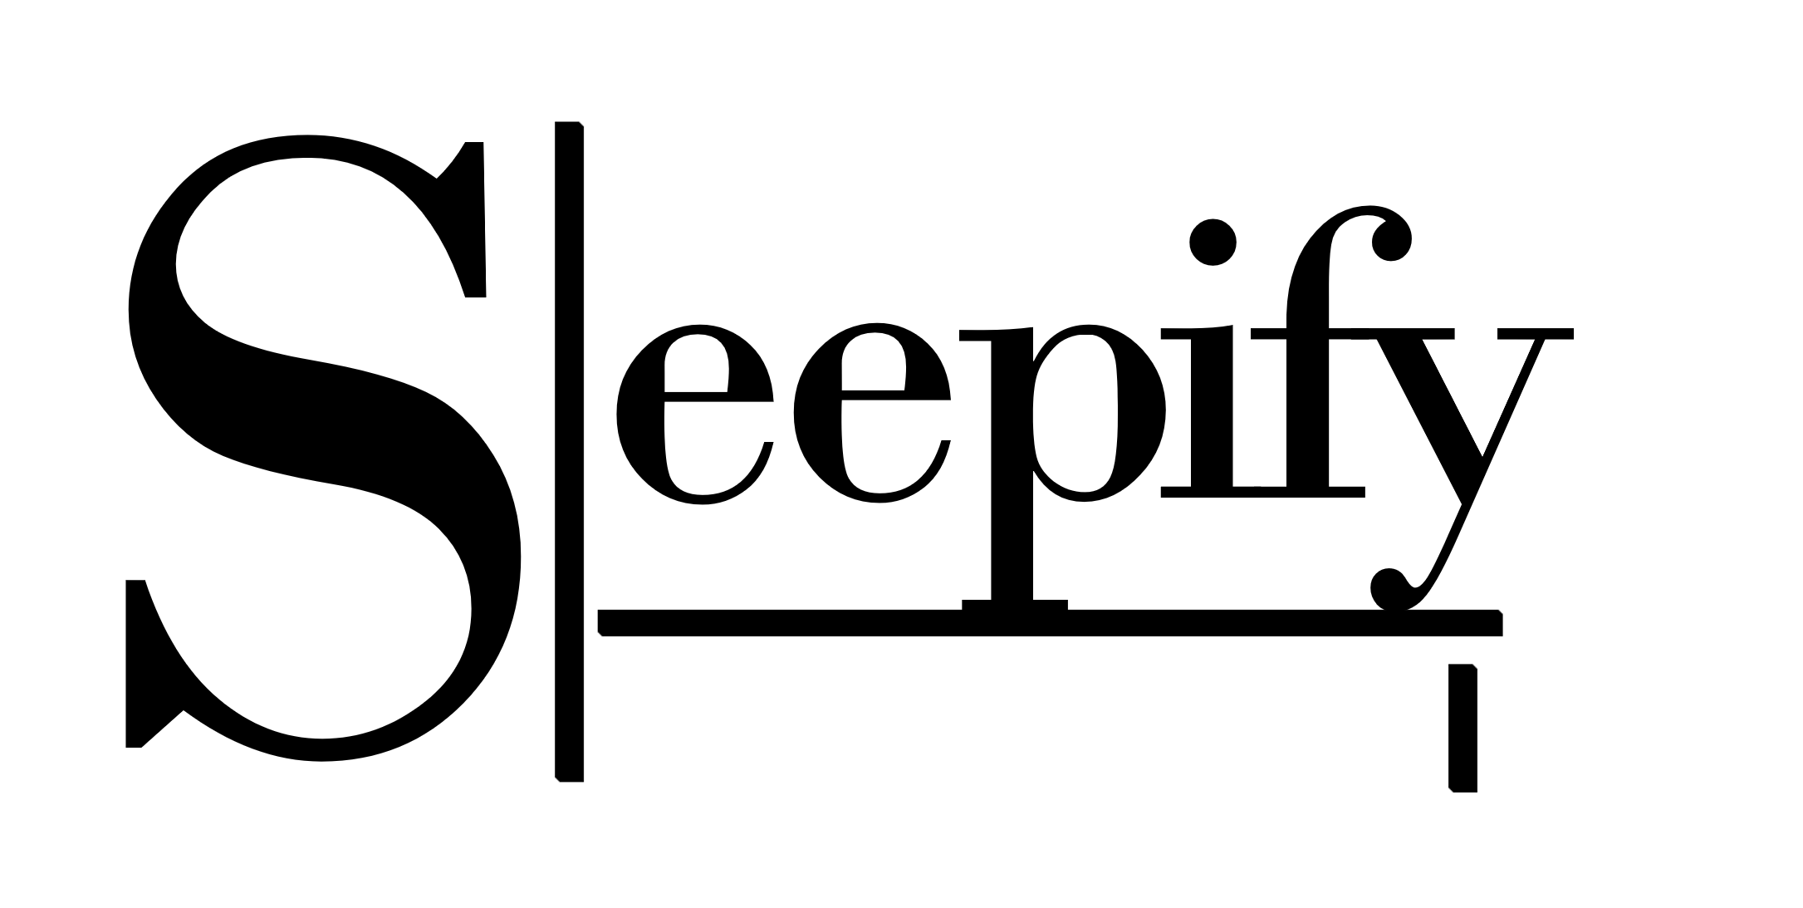
There’s a nap for that.
Jeremy Chan
Tsz Ho Ho
Calvin Lo
Dominic Kwok
Nathalie Wong

Slide 2
At a glance…
Sleepify improves sleep quality depending on temperature
App + the cloud + machine learning + web interface
Non intrusive – wearable
Industry / Our Promise / High Level Design / Backend / Web Interface / Machine Learning / Demo / Testing and Evaluation

Slide 3
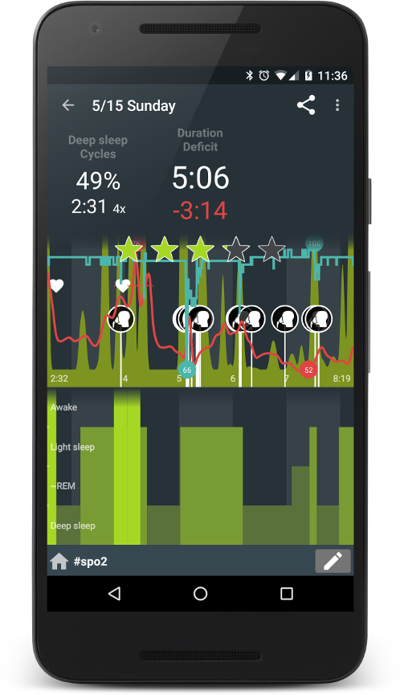
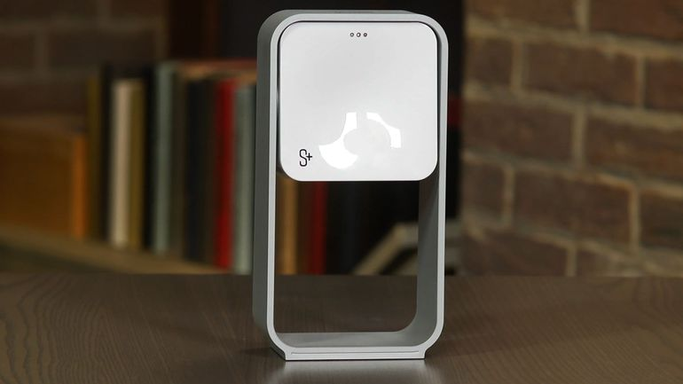
The State of the Industry | Competitors
Focused on sleep tracking
None on temperature and heating
http://sleep.urbandroid.org/wp-content/uploads/screen11-36-44_framed_small.png
https://cnet3.cbsistatic.com/img/s18hHRa4dlAM1fNdtAgfkODoHqY=/770x433/2014/12/16/65bbc9cf-b9d8-4fcb-8b8a-c7ada25c9811/fls-resmed.jpg

Slide 4
Our Promise
Better sleep quality can be achieved by sleeping in an ideal sleeping temperature; we want the environment to not be too cold nor too hot.
Through machine learning, prolonged usage of the app will improve performance and classification accuracy.
Provide a slick, and intuitive app and web interface for the user
The feeling of grogginess can be reduced by:
Reducing the effects of jet-lag by notifying the user to sleep
Setting the alarm to go off when the user is not in deep sleep

Slide 5
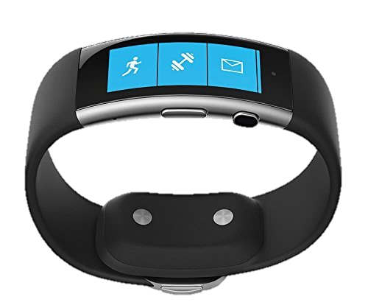

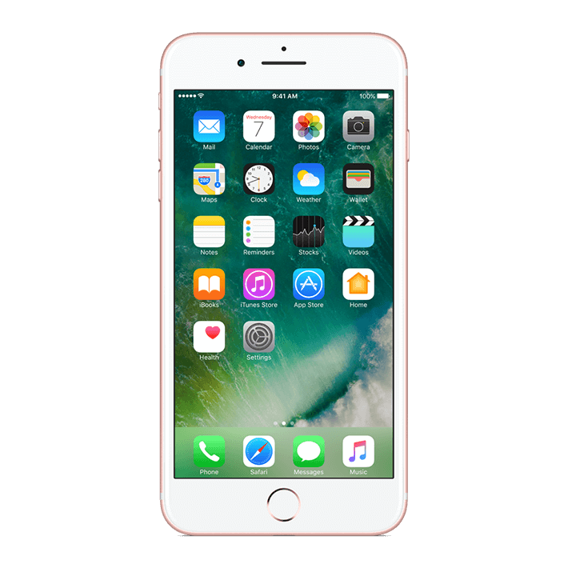



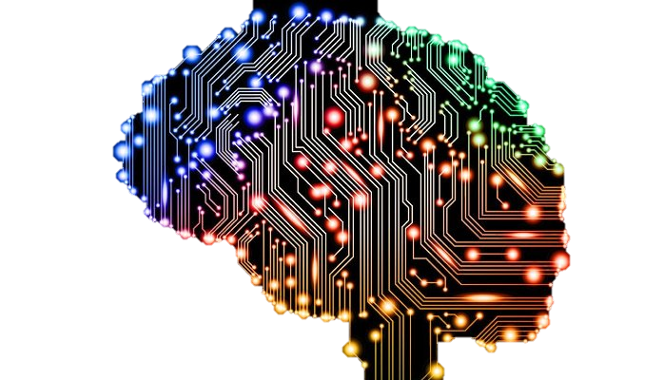
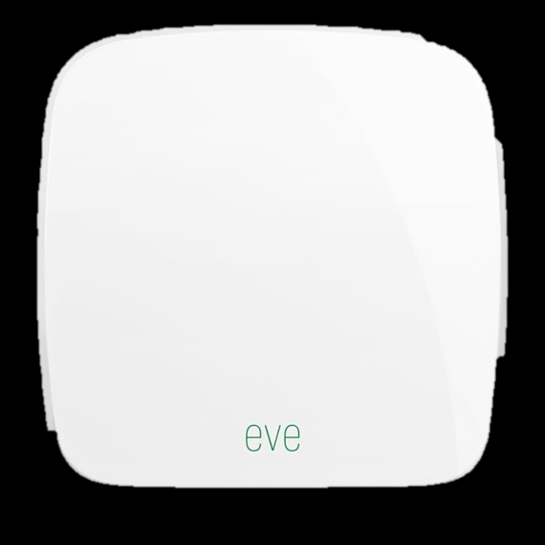

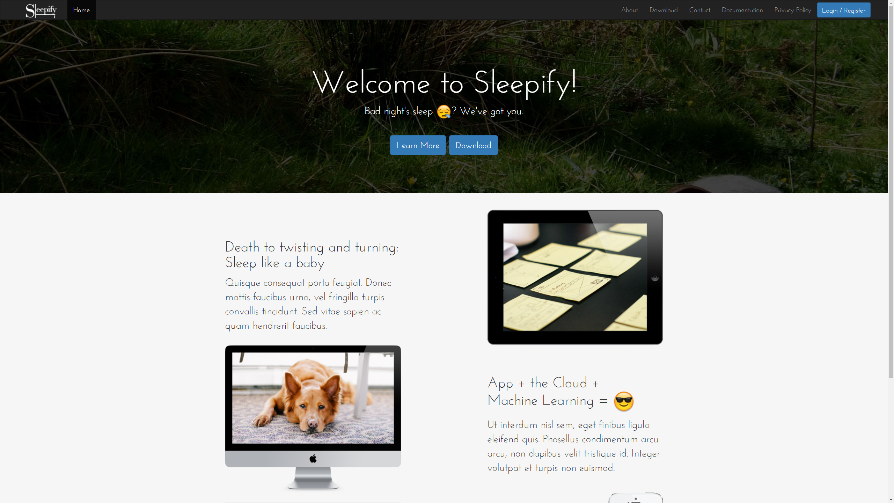
High Level Design
Utilize the cloud
Multiple points of failure
Users have control over data

Slide 6







Backend / Web Interface
django-bootstrap3
djangorestframework
django-sendfile
Sphinx
django-ical
django-cron
django-rest-auth
django-push-notifications
Extremely fast development
Tried, tested, scalable framework
Security issues mostly taken care of

Slide 7

RESTful API
Empowers the other sections
Raw data, graphs, machine learning results, calendar events, notifications
Authentication using sessions/cookies
GET
POST
PUT
DELETE
…
authentication

Slide 8
Machine Learning – Sleep Quality Classification
Polysomnography
Requires EEG / ECG
Expensive, and intrusive to the user
Pittsburgh Sleep Quality Index
Suited for long term classification (1 week+)
Requires constant user feedback via a questionnaire
Actigraphy
Compromise between accuracy and resources
Prioritize real-time aspect
Reduce accuracy problems using machine learning

Slide 9
Machine Learning – Hardware
Microsoft Band 2
Heartrate
GSR
Body Temperature
Acceleration
Elgato Eve Room Smart Plug
iOS Device
Existing sensors and hardware
+Temp, +GSR
Smart plugs replace thermostat integration

Slide 10
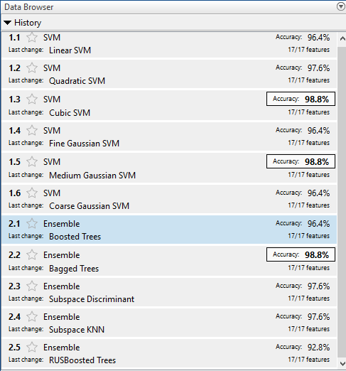
Machine Learning – Software
MATLAB Benchmarking
Python scikit-learn
Extends RESTful API
Choose random forest
Fast training and testing times
Enables online training

Slide 11
Machine Learning – Software
App sends data using API
Train and update the model
Predict based on current data
API stores as features in database
Model is trained in batches
Load the model as a binary file
API sends the result back to the app
Initial prediction from user feedback
Obtain optimum temperature from database
Frequent model updates
Continuous learning

Slide 12
Demo
Modifications
Refresh interval set from 10 minutes -> 10 seconds
Calendar ‘time-to-sleep’ push notification is manually sent.

Slide 13
Hypothesis Testing
Use the Pittsburgh Sleep Quality Index
Before and after a week’s* usage
6 differing subjects
1x good sleeper
3x mediocre sleepers
2x bad sleepers
*) in cases where a full week wasn't done, the results are scaled accordingly
PSQI Questions - http://uacc.arizona.edu/sites/default/files/psqi_sleep_questionnaire_1_pg.pdf

Slide 14


Our Promise
Better sleep quality can be achieved by sleeping in an ideal sleeping temperature; we want the environment to not be too cold nor too hot.
Through machine learning, prolonged usage of the app will improve performance and classification accuracy.
Provide a slick, and intuitive app and web interface for the user
The feeling of grogginess can be reduced by:
Reducing the effects of jet-lag by notifying the user to sleep
Setting the alarm to go off when the user is not in deep sleep

Slide 15
Give it a try!
http://sleepify.zapto.org/download/
©2017 Sleepify. All rights reserved. | Powered by Django and Bootstrap | Created with love from the United Kingdom

